Slide 1
Introduction to Number Theory cont…

Slide 2
Divisibility and the division algorithm
Euclidean algorithm
Modular arithmetic
Prime numbers
Fermat’s and Euler’s theorems
Testing for Primality
Chinese remainder theorem
Discrete logarithms

Slide 3
Prime Numbers
prime numbers only have divisors of 1 and self
they cannot be written as a product of other numbers
note: 1 is prime, but is generally not of interest
eg. 2,3,5,7 are prime, 4,6,8,9,10 are not
prime numbers are central to number theory
list of prime number less than 200 is:
2 3 5 7 11 13 17 19 23 29 31 37 | 41 43 47 53 | 59
61 67 71 73 79 83 89 97 101 103 | 107 109 113 | 127
131 137 139 149 151 157 163 167 | 173 179 181 | 191
193 197 199

Slide 4

Prime Factorisation
to factor a number n is to write it as a product of other numbers: n=a × b × c
note that factoring a number is relatively hard compared to multiplying the factors together to generate the number
the prime factorisation of a number n is when its written as a product of primes
– eg. 91=7×13 ; 3600=2⁴×3²×5²
– It is unique
a is positive Integer & p is prime number

Slide 5
Relatively Prime Numbers & GCD
two numbers a, b are relatively prime if have no common divisors apart from 1
eg. 8 & 15 are relatively prime since factors of 8 are 1,2,4,8 and of 15 are 1,3,5,15 and 1 is the only common factor
conversely can determine the greatest common divisor by comparing their prime factorizations and using least powers
eg. 300=2¹×3¹×5² 18=2¹×3² hence
GCD(18,300)=2¹×3¹×5⁰=6

Slide 6
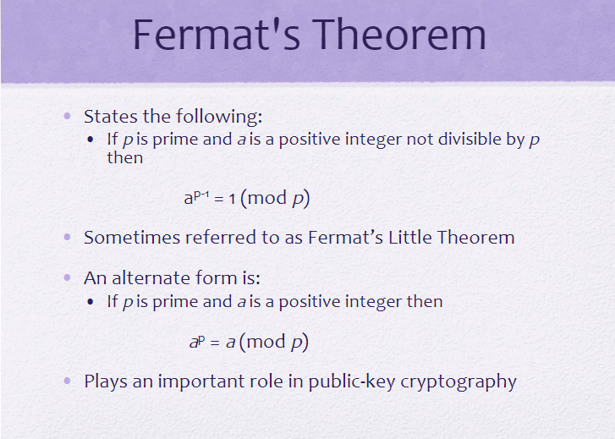
Fermat's Little Theorem

Slide 7
If p=5,a=3 a^{p}=3⁵ = 243 =3 mod 5= a mod p
If p=5,a=10 a^{p}=10⁵ =100000 = 3 mod 10= a mod p

Slide 8
Euler Totient Function ø(n)
when doing arithmetic modulo n
complete set of residues is: 0..n-1
reduced set of residues includes those numbers which are relatively prime to n
eg for n=10,
complete set of residues is {0,1,2,3,4,5,6,7,8,9}
reduced set of residues is {1,3,7,9}
Euler Totient Function ø(n):
number of elements in reduced set of residues of n
– ø(10) = 4

Slide 9
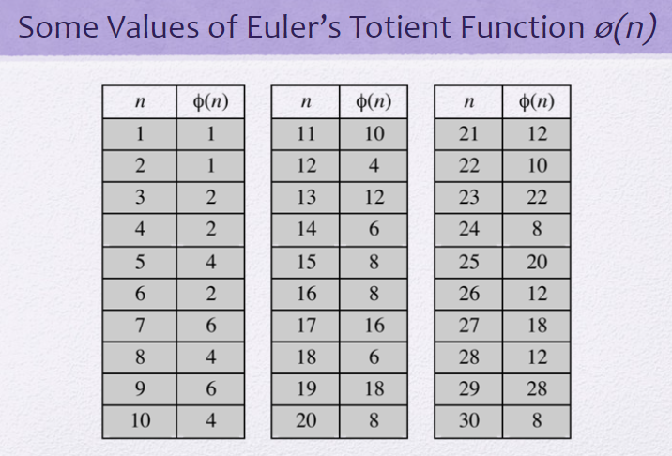

Slide 10
Euler Totient Function ø(n)
to compute ø(n) need to count number of elements to be excluded
in general need prime factorization, but
for p (p prime) ø(p) = p-1
for p.q (p,q prime) ø(p.q) = (p-1)(q-1)
eg.
– ø(37) | = | 36
– ø(21) | = | (3–1)×(7–1) | = | 2×6 | = | 12

Slide 11
Euler's Theorem
a generalisation of Fermat's Theorem
a^{ø(n)}mod n = 1
where gcd(a,n)=1
eg.
a=3;n=10; ø(10)=4;
hence 3⁴ = 81 = 1 mod 10
a=2;n=11; ø(11)=10;
hence 2¹⁰ = 1024 = 1 mod 11

Slide 12
Primality Testing
A number of cryptographic algorithms need to find large prime numbers
traditionally sieve using trial division
ie. divide by all numbers (primes) in turn less than the square root of the number
only works for small numbers
statistical primality tests
for which all primes numbers satisfy property
but some composite numbers, called pseudo-primes, also satisfy the property, with a low probability
Prime is in P:
Deterministic polynomial algorithm found in 2002

Slide 13
Miller Rabin Algorithm
a test based on Fermat’s Theorem
algorithm is:
TEST (n) is:
Find biggest k, k > 0, so that (n–1)=2^{k}q
Select a random integer a, 1<a<n–1
if a^{q} mod n = 1 then return (“maybe prime");
for j = 0 to k – 1 do
if (a^{(2j)q} mod n = n-1)
then return(" maybe prime ")
return ("composite")
Proof and examples

Slide 14
Probabilistic Considerations
if Miller-Rabin returns “composite” the number is definitely not prime
otherwise is a prime or a pseudo-prime
chance it detects a pseudo-prime is < ¼
hence if repeat test with different random a then chance n is prime after t tests is:
Pr(n prime after t tests) = 1-4^{-t}
eg. for t=10 this probability is > 0.99999

Slide 15
Prime Distribution
there are infinite prime numbers
Euclid’s proof
prime number theorem states that
primes near n occur roughly every (ln n) integers
since can immediately ignore evens and multiples of 5, in practice only need test 0.4 ln(n) numbers before locate a prime around n
note this is only the “average” sometimes primes are close together, at other times are quite far apart

Slide 16
Chinese Remainder Theorem
Used to speed up modulo computations
Used to modulo a product of numbers
– eg. mod M = m₁m₂..m_{k} , where gcd(m_{i},m_{j})=1
Chinese Remainder theorem lets us work in each moduli m_{i} separately
since computational cost is proportional to size, this is faster than working in the full modulus M

Slide 17

Chinese Remainder Theorem
to compute (A mod M) can firstly compute all (a_{i} mod m_{i}) separately and then combine results to get answer using:

Slide 18
example
Chinese Reminder Theorem standard equation X ≡ ai mod mi X ≡ a1 mod m1 X ≡ a2 mod m2 X ≡ a3 mod m3 Step 1: - gcd (m1, m2) = gcd (m2, m3) = gcd (m1, m3) = 1 All are co-prime
Step 2: - x = (M1 X1 a1 + M2 X2 a2 + M3 X3 a3 + M4 X4 a4 …………...+ Mn Xn an) mod M where M = m1 * m2 * m3 …………. mn Mi = M / mi For example: - M1 = M / m1 Mi Xi = 1 mod mi [Xi – Multiplicative Inverse] For example: - M1 X1 = 1 mod m1
Numerical X ≡ 1 mod 5 X ≡ 1 mod 7 X ≡ 3 mod 11

Slide 19
Compare above equation with this standard equation X ≡ ai mod mi a1 = 1, a2 = 1, a3 = 3 & m1 = 5, m2 = 7, m3= 11 Step 1: - gcd (m1, m2) = gcd (m2, m3) = gcd (m1, m3) = 1 gcd (5,7) = gcd (7,11) = gcd (5,11) = 1 All are co-prime X exists. Step 2: - x = (M1 X1 a1 + M2 X2 a2 + M3 X3 a3 + M4 X4 a4 …………...+ Mn Xn an) mod M where M = m1 * m2 * m3 …………. mn M = 5 * 7* 11 = 385
Mi = M / mi M1 = M / m1 = 385 / 5 = 77 M2 = M / m2 = 385 / 7 = 55 M3 = M / m3 = 385 / 11 = 35
Mi Xi = 1 mod mi [Xi – Multiplicative Inverse] M1 X1 = 1 mod m1 77 X1 = 1 (mod 5) ……… [77 % 5 = 2] 2 X1 = 1 (mod 5) ……… [Check all possible values of X1 so we get reminder as 1]

Slide 20
X1 = 3 ……………. [2 * 3 = 6 mod 5 = 1]
M2 X2 = 1 mod m2 55 X2 = 1 (mod 7) ……… [55 % 7 = 6] 6 X2 = 1 (mod 7) ……… [Check all possible values of X2 so we get reminder as 1] X2 = 6 ……………. [6 * 6 = 36 mod 7 = 1]
M3 X3 = 1 mod m3 35 X3 = 1 (mod 11) ……… [35 % 11 = 2] 2 X3 = 1 (mod 11) ……… [Check all possible values of X3 so we get reminder as 1] X3 = 6 ……………. [2 * 6 = 12 mod 11 = 1]
X1 = 3, X2 = 6, X3 = 6, M1= 77, M2= 55, M3= 35 a1 = 1, a2 = 1, a3 = 3, m1 = 5, m2 = 7, m3= 11

Slide 21
x = (M1 X1 a1 + M2 X2 a2 + M3 X3 a3) mod M = (77 * 3 * 1 + 55 * 6 * 1 + 35 * 6 * 3) mod 385 = (231 + 330 + 630) mod 385 = 1191 mod 385 = 36 x = 36
To Verify the answer: - x mod mi = ai 36 mod 5 = 1 36 mod 7 = 1 36 mod 11 = 3

Slide 22
Exponentiation mod p
A^{x} = b (mod p)
from Euler’s theorem have a^{ø(n)} mod n=1
consider a^{m} mod n=1, GCD(a,n)=1
must exist for m= ø(n) but may be smaller
once powers reach m, cycle will repeat
if smallest is m= ø(n) then a is called a
primitive root

Slide 23
Discrete Logarithms or Indices
the inverse problem to exponentiation is to find the discrete logarithm of a number modulo p
Given a, b, p, find x where a^{x} = b mod p
written as x=log_{a} b mod p or x=ind_{a,p}(b)
Logirthm may not always exist
x = log₃ 4 mod 13 (x st 3^{x} = 4 mod 13) has no answer
x = log₂ 3 mod 13 = 4 by trying successive powers
whilst exponentiation is relatively easy, finding discrete logarithms is generally a hard problem
Oneway-ness: desirable in modern cryptography

Slide 24
Summary
have considered:
prime numbers
Fermat’s and Euler’s Theorems
Primality Testing
Chinese Remainder Theorem
Discrete Logarithms

